Slide 1


Recommender Systems: Big basket
Recommender systems are intelligent algorithms that suggest relevant items to users. They analyze user behavior and preferences to provide personalized recommendations, enhancing the shopping experience and increasing sales for e-commerce platforms like Big Basket.
G Pavan Sujith
AP22110010342
CSE L

Slide 2
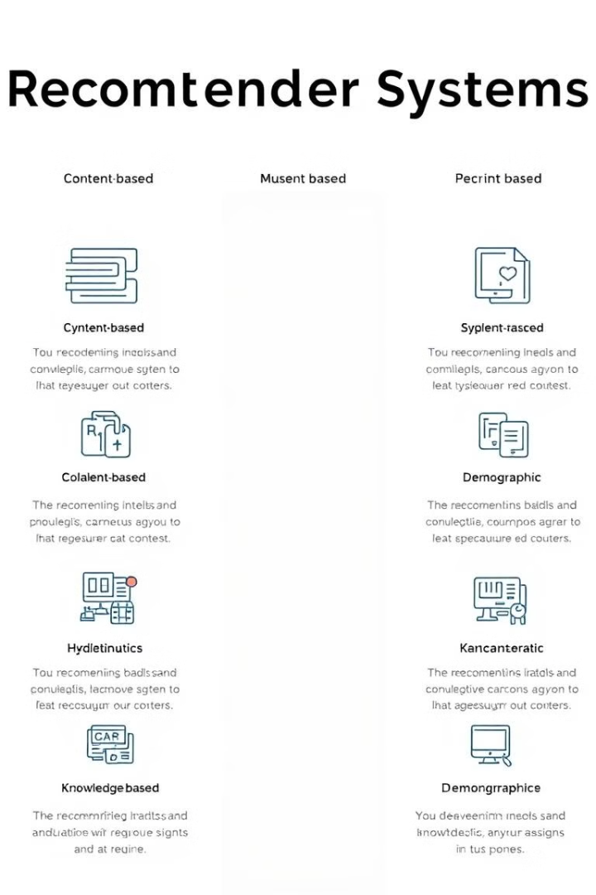
Types of Recommender Systems
1
Content-Based Filtering
2
Collaborative Filtering
Suggests items based on preferences of similar users.
Recommends items similar to those a user has liked in the past.
3
Hybrid Approaches
Combines multiple techniques for more accurate recommendations.

Slide 3

Big Basket: A Case Study in E-commerce Recommendations
Company Overview
Recommendation Challenge
Implementation
Big Basket is India's largest online grocery store, offering a wide range of products.
With thousands of products, suggesting relevant items to each user is crucial for success.
Big Basket uses sophisticated recommender systems to personalize the shopping experience.

Slide 4
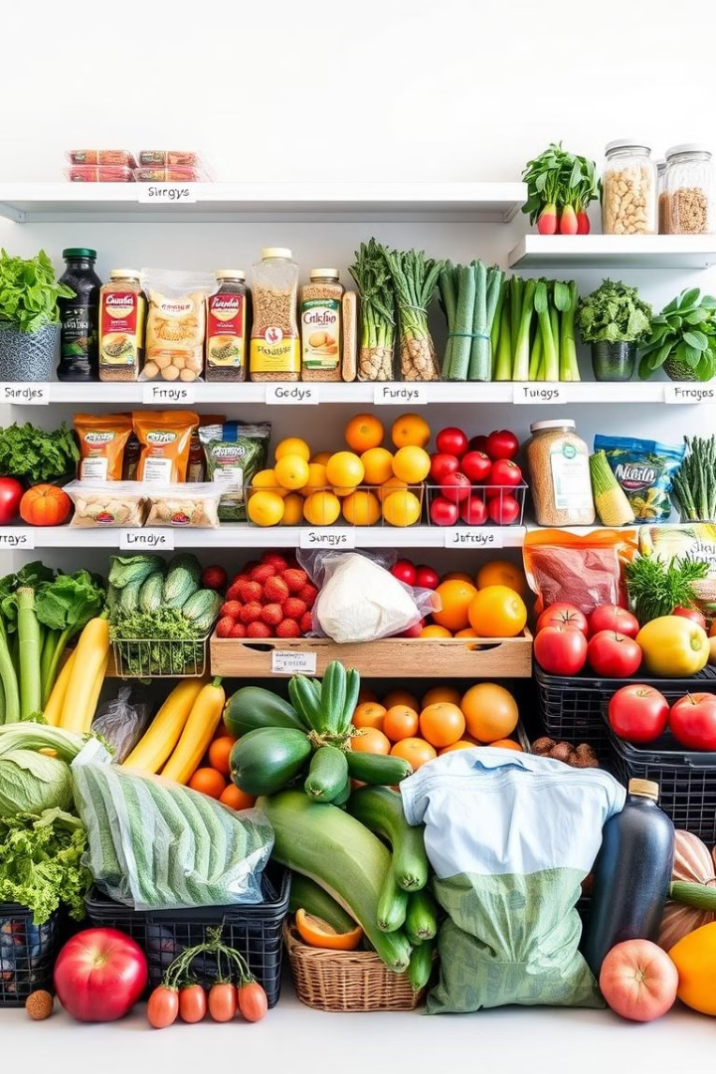

Content-Based Filtering in Big Basket
1
Item Profiling
Big Basket creates detailed profiles for each product, including attributes like category and nutritional info.
2
User Preferences
The system analyzes user behavior to understand individual preferences and dietary requirements.
3
Matching Algorithm
Recommendations are generated by matching user preferences with item profiles.

Slide 5
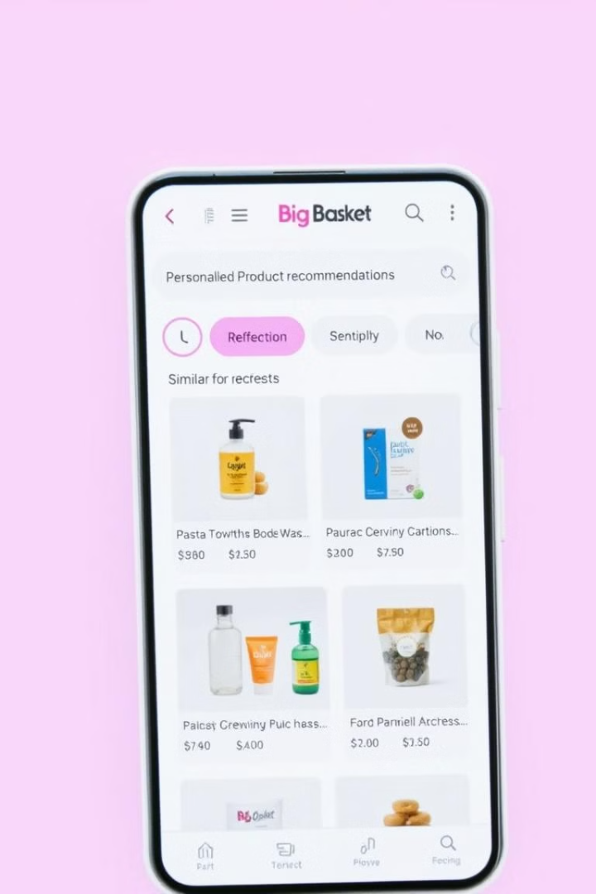

Content-Based Filtering: Big Basket Example
Past Purchase: Organic Apples
Recommendation: Organic Bananas
The system identifies key attributes: organic, fruit, health-conscious.
Similar attributes are matched to suggest relevant products.
Personalized Results
Users receive tailored suggestions that align with their preferences and buying history.

Slide 6





Collaborative Filtering in Big Basket
User Similarity
Big Basket identifies users with similar shopping patterns and preferences.
Item Rating Prediction
The system predicts how a user might rate items based on similar users' ratings.
Recommendation Generation
High-rated items from similar users are recommended to the target user.

Slide 7


Collaborative Filtering: Big Basket Example
User A
User B
User C (Target)
Bread, Milk, Eggs
Bread, Milk, Cheese
Bread, Milk, ?
Recommendation: Cheese
Recommendation: Eggs
Recommendation: Eggs or Cheese

Slide 8
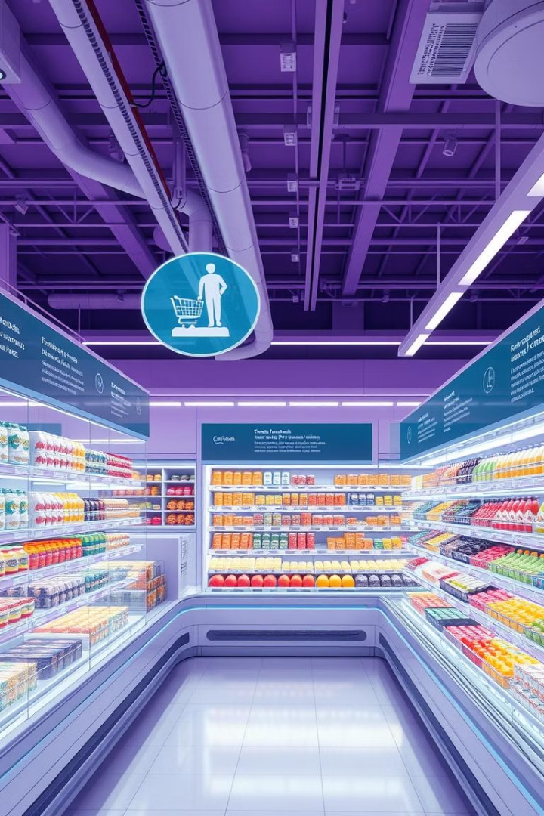



The Future of Recommender Systems in E-commerce
AI Integration
Advanced AI will enhance recommendation accuracy and personalization.
Virtual Shopping
VR and AR will create immersive, personalized shopping experiences.
Privacy-Focused
New techniques will balance personalization with user data protection.

Slide 9


